Slide 1
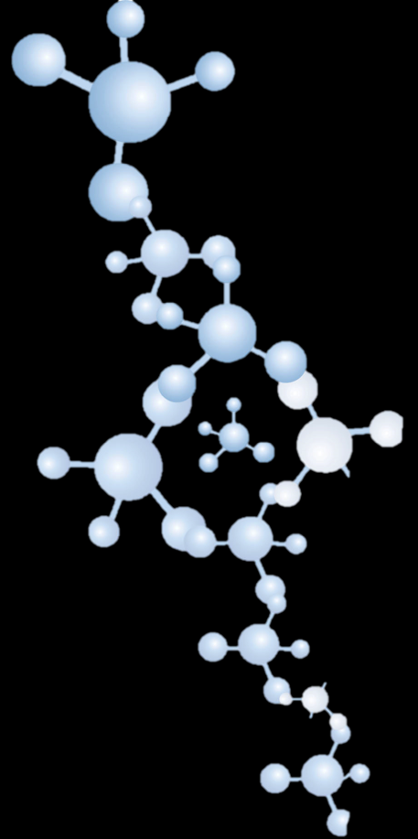

NTI Nanotech International
Leaders in 21st Century Nanotechnology
Industrial Magnetic Filtration Technology

Slide 2
Introduction to
NTI Nanotech International
Privately owned Canadian company based in
Edmonton, Alberta
Specializes in nanotechnology based decontamination
Specializes in Nano Magnetic Separation
Extensive environmental consulting experience capable of fielding world class multi-disciplinary teams
Previous projects include: soil stabilization for mining roads, PCB decontamination, arsenic decontamination, hydrocarbon & heavy metal remediation, tailings sedimentation, oil recovery research

Slide 3
MAGNETIC SEPARATORS
Core Design
Core design is a stand-alone Magnetic Separator module, designed for continuous operation
Multiple modules are assembled in parallel to accommodate system operating capacity and cleaning requirements. Additional modules can be added to increase system capacity if demand arises in the future.

Slide 4
Applications
  Fuel
  Lubricants
  Hydraulics
  Coolants
  Water/effluents
  Chemicals
  Gas systems
  Slurries (tailings, etc)
In-line/Flow-through
Multiple designs and custom designs
Functional Nano Particles are injected to remove NON-FERROUS SUBSTANCES as well as enhance the effectiveness on ferrous substances
No internal flow restrictions

Slide 5
FEATURES
System stays online during cleaning operations, so no shutdown is required for routine cleaning.
Minimal human contact with the material removed during cleaning procedure. Easy and safe management of filtrated substances when removed from the system.
Main system is housed in a building which includes a dedicated overhead crane system used for routine cleaning operations, as well as for equipment installation and servicing.
System is PLC controlled and remote monitored with an integrated camera system.
Minimal flow restriction (~0.5 psi) per module means less horse power required for operation.
Operational pressure drop is minimally affected by material buildup
Minimal consumables required for normal operations.
Robust separator components require minimal maintenance

Slide 6
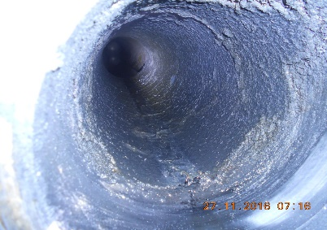
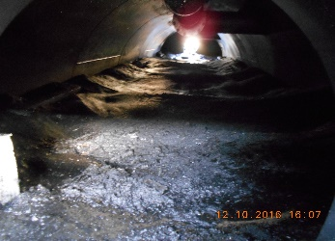
MAGNETIC SEPARATION OF BLACK POWDER and other SUBSTANCES
Black Powder is a general term used to describe a host of corrosion related contaminants found in pipelines that transport natural gas, hydrocarbon condensates, and liquefied petroleum gas (LPG).
It can also make its way from the pipeline to downstream processes damaging equipment through plugging and erosion.
The composition of Black Powder has been found to vary significantly in chemical composition and to contain very fine particles down to sub-micron sizes.
It can be a dry powder, a liquid suspension, or an intermediate sticky sludge depending on pipeline conditions.

Slide 7
MAGNETIC SEPARATION OF BLACK POWDER and other SUBSTANCES
Key Features
Particle removal: The Magnetic Nano Separator Module removes ferrous AND non-ferrous particles > 100 microns to sub-micron levels, at efficiencies exceeding industries standards.
Fully redundant system: The system has two parallel duplex sets of separator modules; scheduled and unscheduled system maintenance can be performed with NO INTERRUPTION to operations.
Fully automated cleaning: Each separator module includes an enclosed actuated cleaning system to clean Black Powder and other contaminants from the magnetic separators. The required cleaning frequency can be adjusted remotely with NO DOWNTIME to either side of the Duplex System.
Remote monitoring: The system is PLC controlled and has options for remote monitoring via TCP/IP and an integrated camera system.

Slide 8
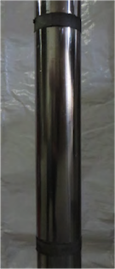
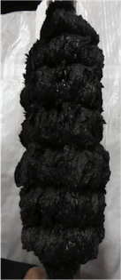
Key Features Cont.
Black Powder & moisture handling: All Black Powder is flushed through a waste handling system with potassium permanganate solution and discharged directly to a settling tank or other waste water facility.
No human contact: There is no direct human contact with Black Powder. Cleaning is automated and remotely monitored.
System effectiveness feedback: Black Powder removal effectiveness is measured in real time. Sensors detect a decrease in effectiveness and respond by increasing auto-cleaning frequency, starting with the module with the highest pressure drop.
Black Powder capacity: Each module can hold 125 ft3 of Black Powder.
Crude delivery capacity: Current system capacity 500k BBL/Day.

Slide 9
Key Features Cont.
Pressure drop: Operational pressure drop is minimally affected by Black Powder buildup.
Minimal flow restriction: Pressure drop of approximately 0.5 psi per module means less horse power required for to maintain flow volumes.
Building: Main system is housed in a building which includes a dedicated overhead crane system used for equipment installation and servicing.
Consumables: No consumables are required for daily function. Minimal consumables (mainly seals & wipers) are replaced annually or as needed.
Robustness: Robust separator components require minimal maintenance.
Modular design: The system is fully scalable and modular to accommodate ALL lines sizes, pressures, and volumes.

Slide 10
Crude Oil System Cross Section
Overview of system
Manifold with 8 separator modules

Slide 11
CONTACT: NTI NANOTECHNOLOGY CORP.
Negus Enterprises Ltd. (Agents for Nanatechnology Corp)
Winston Hawthorne
  +1 (780) 709 0661
  winston@negusenterprisesltd.com
Rainer Maas (President)
  +1 (604) 202 5817
  Rainer.maas@nanotechinternational.com
Dr Tony Leske (Technical Manager)
  +1 (780) 690 4158
  tony.leske@nanotechinternational.com

